Slide 1

ARSS
Autonomous Response System for SOC (Security Operations Centre)
An AI triage assistant that adapts to how busy the security team is.
Team
Muhammad Daniyal (2023406)
Muhammad Haider Iqbal (2023416)
Syed Daud (2023677)
Supervisors
Dr. Muhammad Fawad Khan (Supervisor)
Miss Hadia Abbas (Co-Supervisor)
BS Cybersecurity, FCSE, GIKI

Slide 2



What Is a SOC?
A SOC is the team that watches an organization’s network 24/7 to detect and respond to cyber threats.
Alert
SOC
Triage
A security tool flags something suspicious.
Security Operations Centre
Deciding for each alert: real threat or false alarm, and what gets looked at first.
The team of analysts who check those alerts.
SIEM (Security Information and Event Management) = the dashboard where alerts arrive (for example, Splunk, our target platform).
Tools raise alerts, analysts check them, and triage decides which get attention first.

Slide 3


Alerts Are Going Unattended
49%
of assigned alerts get resolved within a workday
51%
of SOC teams feel overwhelmed by alert volume
Alerts pile up
78%
of companies cut SOC staffing by 50%+ on weekends and holidays
52%
of organizations report ransomware targeting on weekends and holidays
Staff drop when attackers don’t
Detection works. So why do alerts still go unattended?
Detection isn’t the bottleneck; analyst capacity is, and it shrinks on weekends and holidays when ransomware is common.
Tariq, S., Baruwal Chhetri, M., Nepal, S., & Paris, C. (2025). Alert fatigue in security operations centres: Research challenges and opportunities. ACM Computing Surveys, 57(9), 1-38.
Semperis. (2025). 2025 ransomware holiday risk report. https://www.semperis.com/wp-content/uploads/resources-pdfs/reports/resources-semperis-ransomware-holiday-risk-report.pdf
.

Slide 4
Literature & Background
Lázaro et al. (2026)
AI-driven alert triage with human-in-the-loop
Tong et al. (2020)
Alert prioritization with adversarial reinforcement learning
Only suggests a decision to a human; doesn’t act on its own
Handles just two coarse yes/no decisions
Built for managed SOCs (a company running security for clients), not clearly for in-house ones
Unclear if tested on live alerts or only on old recorded data
Analyst budget is a fixed constant, never a live input
Queue resets every period, so backlog never builds up
Headline 20% gain is best-of-4 categories and drops to zero under cheap, frequent feint attacks
Uses DDPG (built for continuous actions), a poor fit for discrete close / defer / escalate
LIMITATION
Advises a human with two coarse calls, so it can’t triage on its own.
LIMITATION
Workload is a fixed budget and the queue resets, so real backlog never shapes decisions.
Both papers leave the same gap: no system decides on its own from live SOC workload. ARSS is built to close it.
Lázaro, Marcelino & Álvarez-Pérez, Lorena & Gonzalez-Serrano, Francisco-Javier & Gutiérrez-López, Aitor & Álvarez-Aldana, José-Luis & Gil-López, Marta & Izquierdo-Núñez, Andrés & Montero-Santos, Jairo. (2026). AI-Driven Alert Triage in Security Operations Centers: Imbalanced Learning with Human-in-the-Loop Contextual Bias Modeling. 10.1007/978-3-032-30805-4_11.
Tong, Liang & Laszka, Aron & Yan, Chao & Zhang, Ning & Vorobeychik, Yevgeniy. (2020). Finding Needles in a Moving Haystack: Prioritizing Alerts with Adversarial Reinforcement Learning. Proceedings of the AAAI Conference on Artificial Intelligence. 34. 946-953. 10.1609/aaai.v34i01.5442.

Slide 5
Proposed Solution: ARSS
ARSS is an AI triage system that decides what happens to each alert, using the alert’s risk and how loaded the SOC is right now.
Alert Understanding
Severity Floor
01
02
Reads each incoming alert and labels its attack type, risk score and how confident the model is.
A hard rule: high-severity alerts skip the decision and always go to a human.
SOC Workload State
Triage Agent
03
04
A live picture of the team: incoming alerts, capacity, backlog, analysts online, utilization and recent load.
Reads the alert and the workload state, then picks Auto-Close, Defer or Escalate.
ARSS decides close, defer or escalate on its own from the alert plus live SOC workload, and high severity always reaches a human.

Slide 6
How ARSS Works
1
2
3
4
5
Ingest
Understand
Severity floor
Triage agent
Update
Clean and validate the incoming alert.
Work out attack type, risk score and model confidence.
High severity? Straight to a human.
Skips step 4.
Reads the SOC state, then picks Close, Defer or Escalate.
Queue and workload change. Outcome is logged.
Next alert is judged on the updated state
SOC state the triage agent reads
Demand
alerts arriving
Capacity
analyst capacity
Backlog
alerts waiting
Analysts online
availability
Utilization
current load
Recent history
workload trend
Every decision changes the SOC’s state, and the next alert is judged on that updated state.

Slide 7
Four Triage Methods, One Fair Comparison
No method is assumed best, so ARSS tests a fixed rule against increasingly adaptive ones.
SIMPLE
ADAPTIVE
A
Static Threshold
B
Supervised Learning
C
Contextual Bandit
D
Sequential RL
DECIDES BY
DECIDES BY
DECIDES BY
DECIDES BY
Fixed risk-score cutoffs
A model that predicts the right action
Picks the action that pays off best now
Weighs how each action affects later alerts
LEARNS FROM
LEARNS FROM
LEARNS FROM
LEARNS FROM
Nothing; rules are hand-set
Past alerts with known outcomes
A reward after each decision
Trial and reward in the simulated SOC
ADAPTS OVER TIME?
ADAPTS OVER TIME?
ADAPTS OVER TIME?
ADAPTS OVER TIME?
No
Only when retrained
Yes, after every decision
Yes, and plans ahead
All four choose one action per alert: Auto-Close, Defer or Escalate.
Four methods, from a fixed rule to a learning agent, tested on identical conditions to find out which triages best.

Slide 8
Scope
Simulated SOC environment:
  A simulated SOC that generates alerts, manages the queue and models analyst capacity.
Four triage methods:
  Four triage methods evaluated on the same alerts under the same workload conditions.
SOC state:
A workload state capturing the team's current load, used in every triage decision.
Severity floor:
A severity floor that sends high-severity alerts straight to a human.
Splunk as the primary SIEM platform ARSS is designed to work with.
Results show whether the idea works in a controlled simulation, not how it performs in a live SOC.
We test workload-aware triage in a simulation; we don’t deploy it in a real SOC

Slide 9
Why This Is a Complex Computing Problem
# | Attribute | Why it applies to ARSS
1 | Conflicting requirements | Cutting analyst workload means closing more alerts, which risks missing real threats.
2 | Depth of analysis | Four methods compared; none assumed best.
3 | Depth of knowledge | Cybersecurity + machine learning/RL + workload modeling.
4 | Familiarity of issues | Alert automation exists; workload-conditioned triage is insufficiently explored.
5 | Level of problem | Alert analysis, severity rule, workload tracking, decisions and feedback must work as one system.
6 | Consequences | Wrong triage either delays a real response or buries analysts in extra work.
7 | Interdependence | Each decision changes the workload state the next alert is judged on.

Slide 10



SDG Alignment
SDG 9: Industry, Innovation & Infrastructure
PRIMARY
A new workload-aware approach to alert triage.
SDG 8: Decent Work & Economic Growth
SECONDARY
Tests whether it reduces analyst overload.
SDG 16: Peace, Justice & Strong Institutions
SECONDARY
Supports the institutions that depend on SOCs.

Slide 11
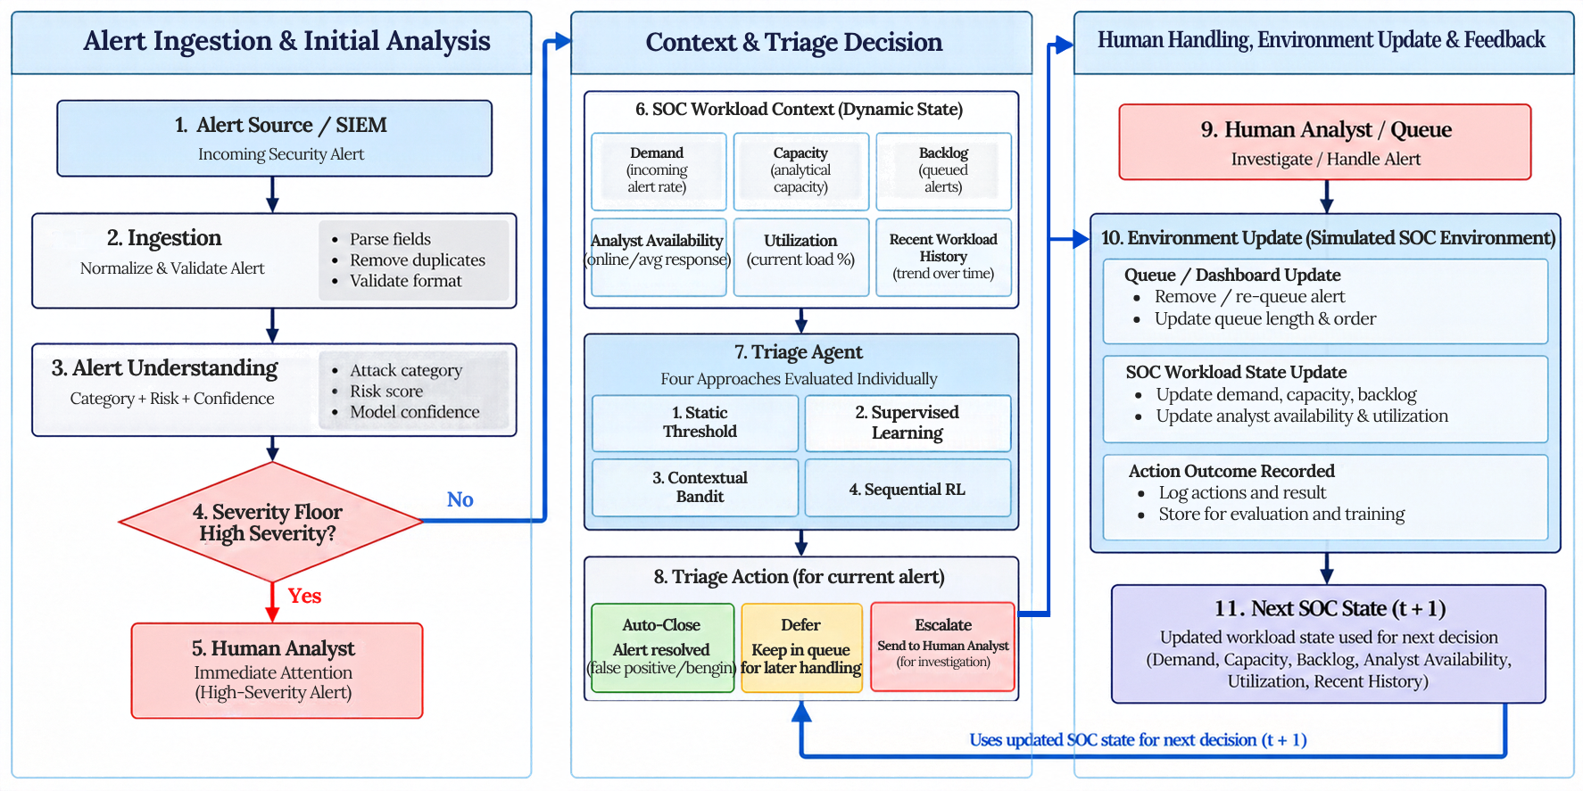
Full System Diagram

Slide 12



What We Will Deliver
1. Simulated SOC environment
2. ARSS prototype
A simulated SOC that models alert flow, the queue and analyst capacity.
A working system that analyses alerts, applies the severity floor and chooses the triage action.
3. Four-method comparison
4. Evaluation evidence
All four methods tested on the same alerts and workload conditions.
Results showing whether workload-aware triage cuts analyst burden without more missed threats.
A simulated SOC, a working ARSS, a four-way comparison, and evidence on whether workload-aware triage helps.

Slide 13
Thank You
Any Questions?
BS Cybersecurity, FCSE, GIKI

